Slide 1
Drone Control Status Update
Adin Sacho-Tanzer and Gabriel Kret

Slide 2
Introduction
Aircraft dynamics simulators are helpful to test controllers without needing to run an expensive real world test
Implementation:
Use quaternions for equations of motion
Use RK4 integrator
Apply linear aerodynamic model over the Rigid Body

Slide 3
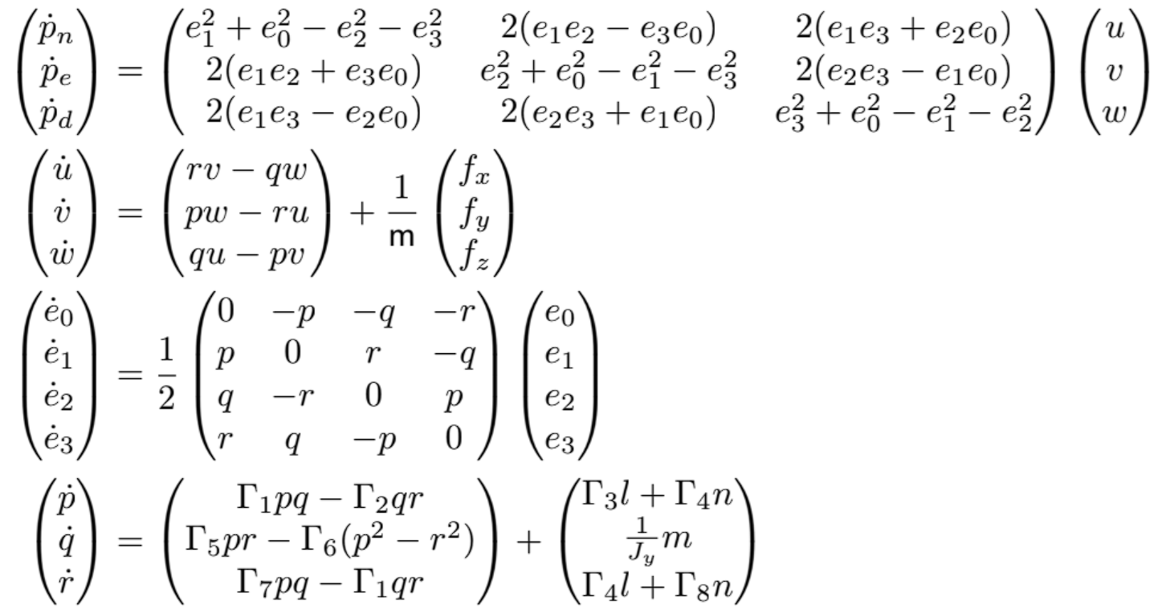
EOMs

Slide 4
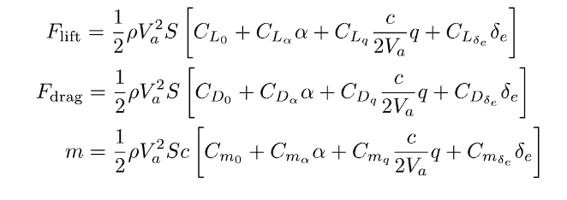
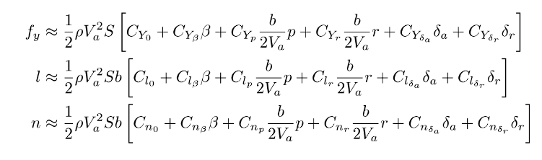
Linear Aerodynamic Model

Slide 5
Implementation
Used code structure from Beard
Rigid body class implements rigid body EOMs,
Aircraft class implements aerodynamics, thrust, gravity
External classes can run simulation using step() function
Testing:
For rigid body EOMs, used simple cases of forces, moments
Rotation about 2nd principal axis
For aerodynamics, used Beard’s chapter 4 test cases

Slide 6

Results
Beard Chapter 4 test cases:
Matched cases 1 and 2 perfectly except for $f_{x}$ and $u_{x}$
Haven’t yet implemented wind, trim, so can’t test further test cases

Slide 7
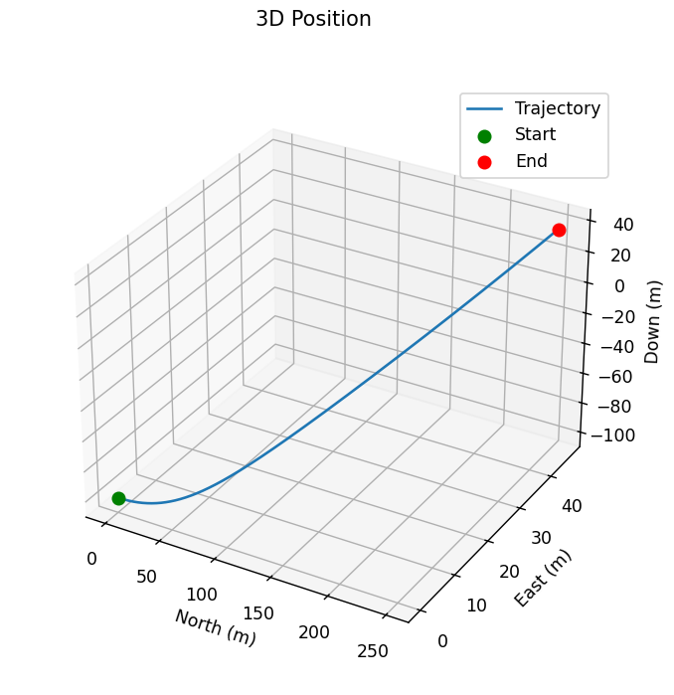
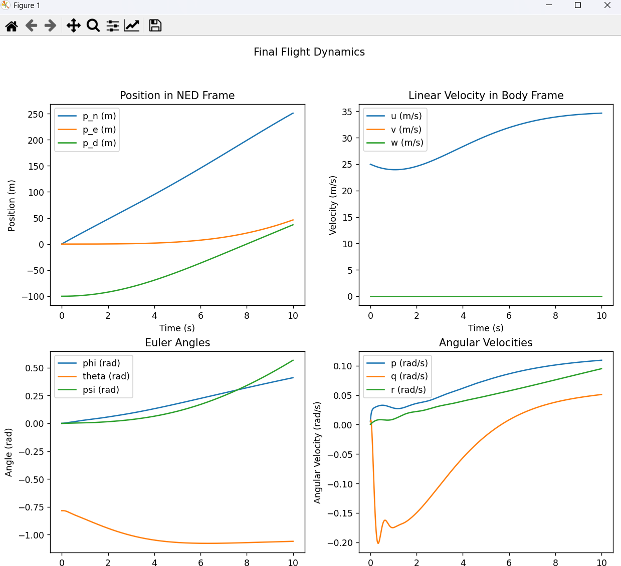

Slide 8
Challenges
Had to restart code using Beard’s structure
Originally implemented our own structure using Euler angles
Ran into persistent errors, couldn’t figure out why
General challenge- testing and debugging is hard
Can really only test using Beard’s cases
When a test fails, it’s extremely hard to figure out where the problem is

Slide 9
Conclusion
There’s more work to be done.
Wind and trim conditions still need to be implemented.

